Slide 1


Power BI Project: Revenue Insights for AtliQ Grands
Hospitality Domain | Data-Driven Business Decisions
Presented by: Khiroda Kumar Gouda
by Khiroda Kumar Gouda

Slide 2

Introduction
Aspiring Data Analyst
Context
AtliQ Grands – upscale luxury hotel chain in India.
Exploring business impact using Power BI.
Objective
Deliver insights to regain market share.

Slide 3

Problem Statement
Challenge
Causes
AtliQ Grands losing revenue and market position.
Ineffective decision making
Rising competition
No internal analytics team
Our Role
External analyst tasked to build data insights dashboard.

Slide 4
Key Metrics Tracked
Room Performance
Market Insights
Total Revenue
Occupancy Rate
ADR (Average Daily Rate)
Revenue by Segment
RevPAR (Revenue per Available Room)
Booking Channel Analysis

Slide 5

Data Preparation
Tool Setup
Utilised Power BI and Power Query Editor.
Data Cleaning
Handled null values and corrected data formats.
KPI Creation
Developed calculated DAX measures essential for analysis.

Slide 6
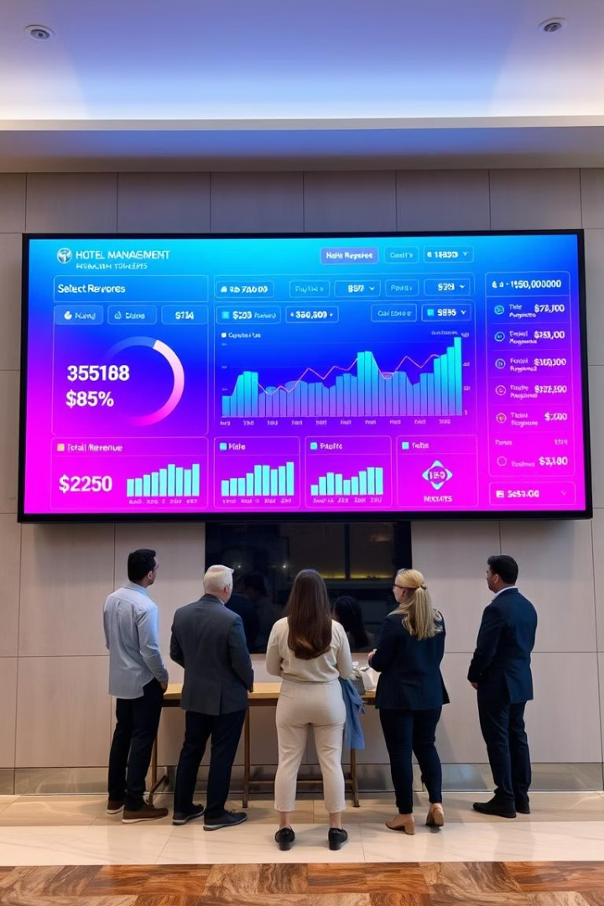
Dashboard Overview
KPI Cards
Visual Charts
Highlighting Revenue, ADR, and RevPAR metrics.
Line chart for monthly trends and bar charts by hotel and segment.
Interactive Filters
Filters for city, room class, and booking platform.

Slide 7




Dashboard Highlights
Seasonality
Customer Segments
Revenue peaks during summer months.
Corporate customers show higher ADRs.
1
2
Booking Channels
4
3
Property Insights
OTA platforms generate high volume but low profit.
Delhi leads revenue but faces high cancellations.

Slide 8





Business Impact for Stakeholders
Hotel Promotion
Targeting underperforming properties for growth.
Booking Strategy
Encouraging direct bookings to improve margins.
Pricing Adjustments
Tailoring rates by customer segment.
Marketing Budget
Optimising spend based on data insights.

Slide 9
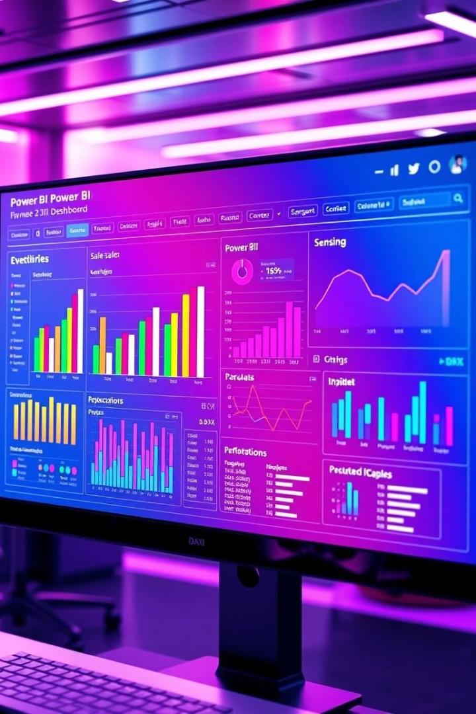
Learnings & Takeaways
Power Query
Mastered data cleaning techniques.
DAX Formulas
Created essential KPI calculations.
Dashboard Storytelling
Built interactive, insightful visual narratives.
Real-World Impact
Linked analytics to actionable business decisions.

Slide 10
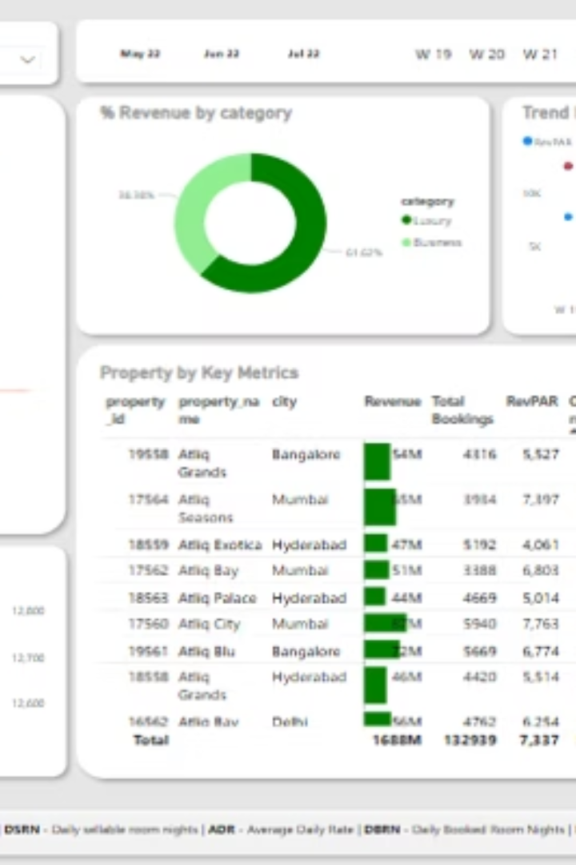
Project Visual Summary
This dashboard integrates key revenue insights for effective hotel management.

